Slide 1
Four Key Economic Issues: A Market Practitioner’s Perspective
Dr. Edward Yardeni
President, Yardeni Research, Inc White House
Washington, DC
December 12, 2018

Slide 2
Four Key Economic Issues
1. US-China Trade & National Security
America is the crouching tiger, while China is the hidden dragon. Hiding in plain sight is that China is seeking to become a super-power before it turns into the world’s largest nursing home.
2. Monetary & Fiscal Policies
Fiscal policy has been stepping on the economy’s accelerator, while the Fed has been tapping on the brakes. Monetary policy has been based on failed macroeconomic models and phantom variables that aren’t observable.
3. Productivity & the Supply Side
Rapid technological change is both disrupting and energizing our economy. The first effect tends to dampen productivity, while the second tends to boost it. Better productivity growth may be starting to show up in real wages.
4. The Stock Market
The stock market has been very volatile this year as a result of the bullish and bearish mix of government policies. The volatility has been greatly exacerbated by algorithm trading systems. It’s time to bring back the uptick rule.

Slide 3
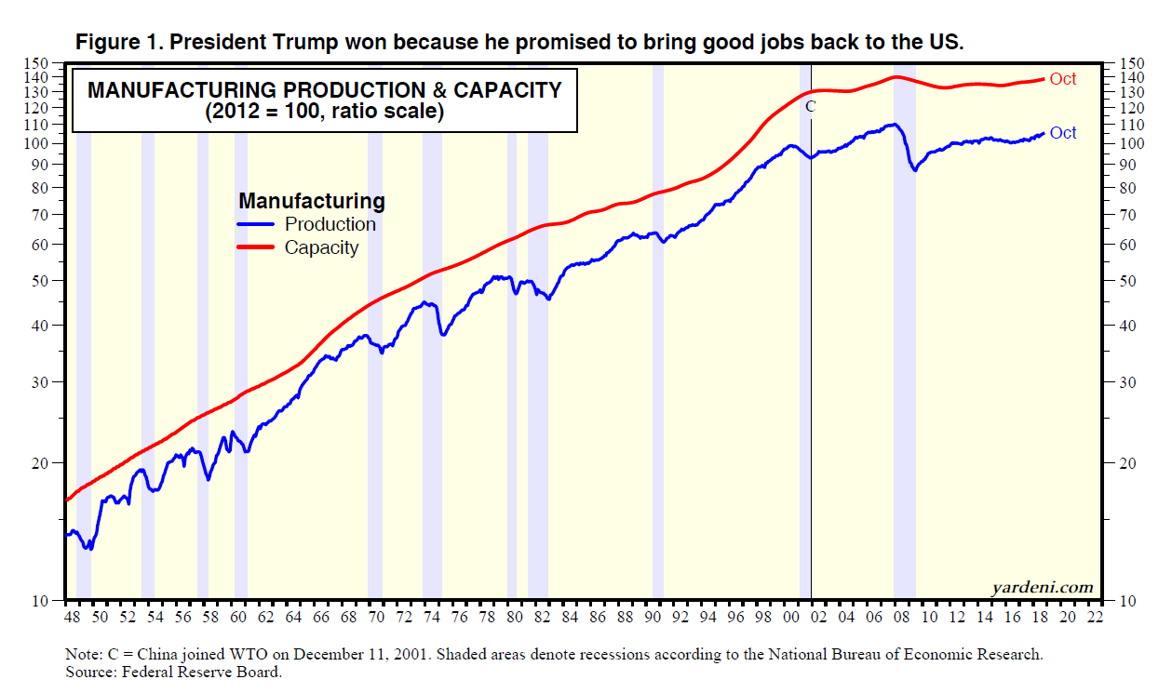

Slide 4
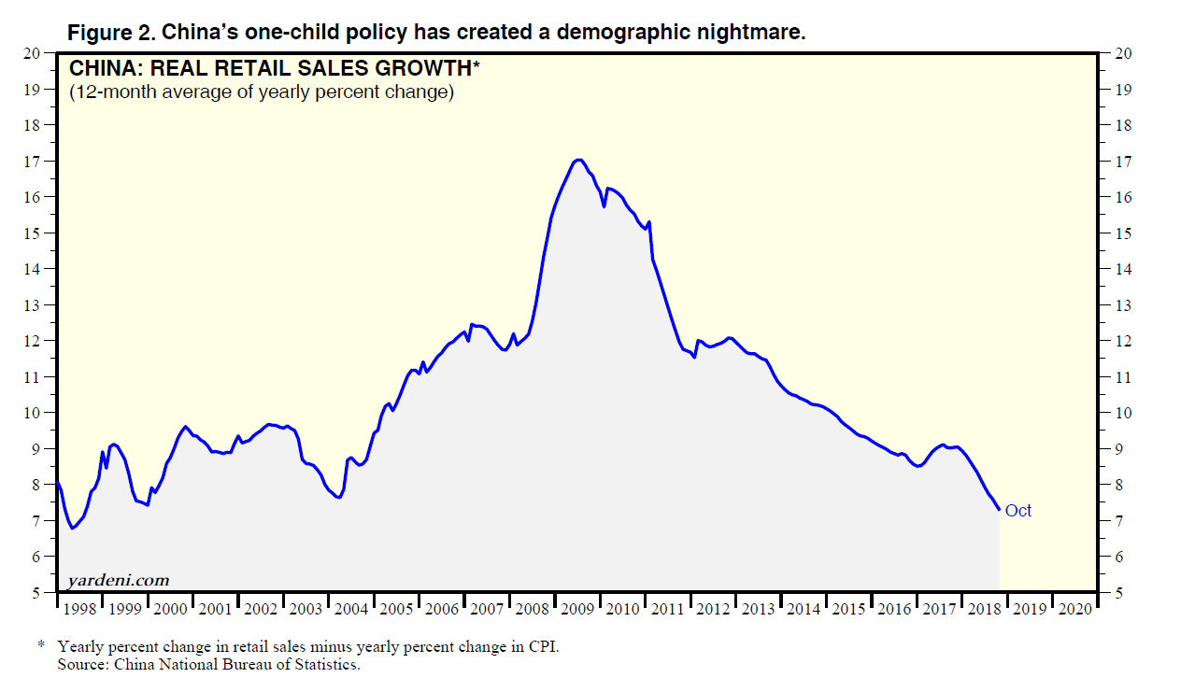

Slide 5
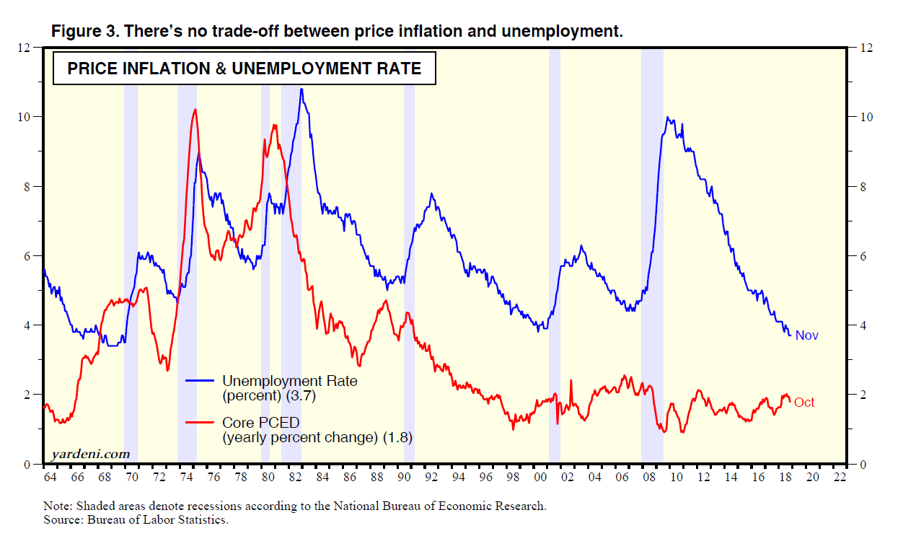

Slide 6
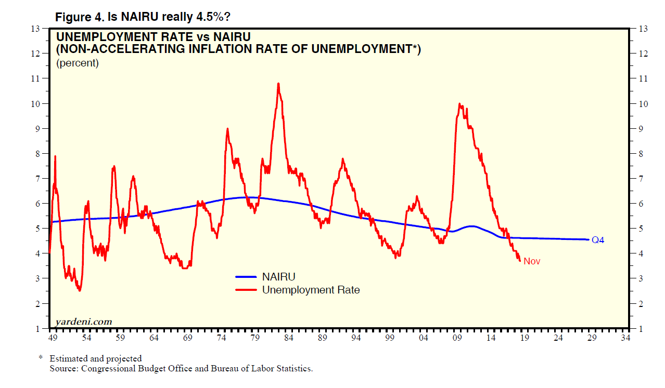

Slide 7
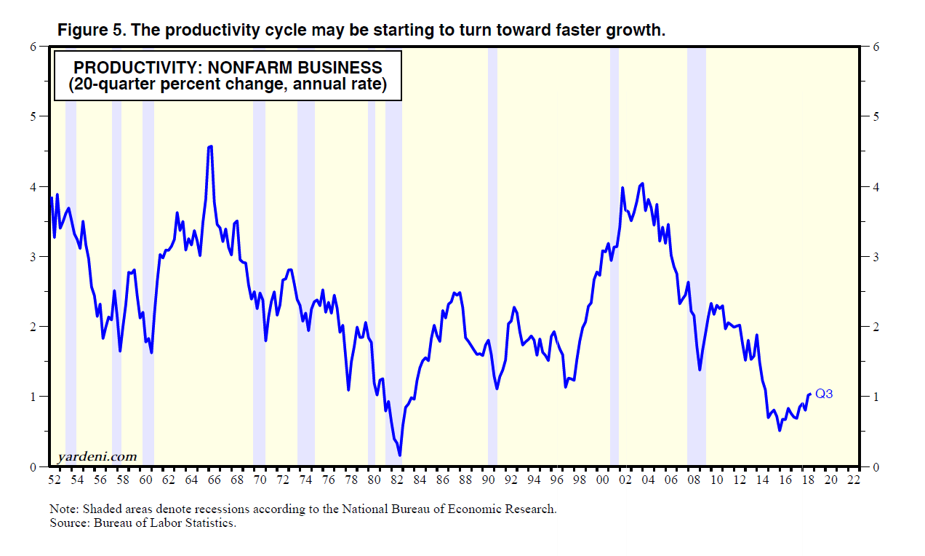

Slide 8
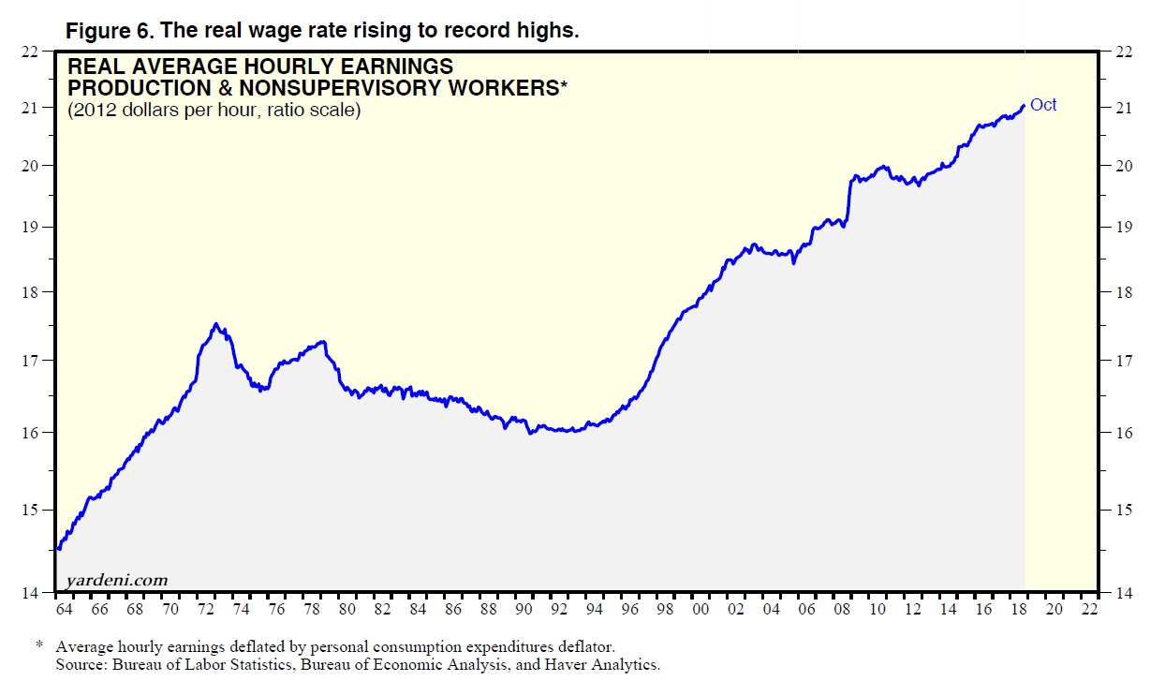

Slide 9
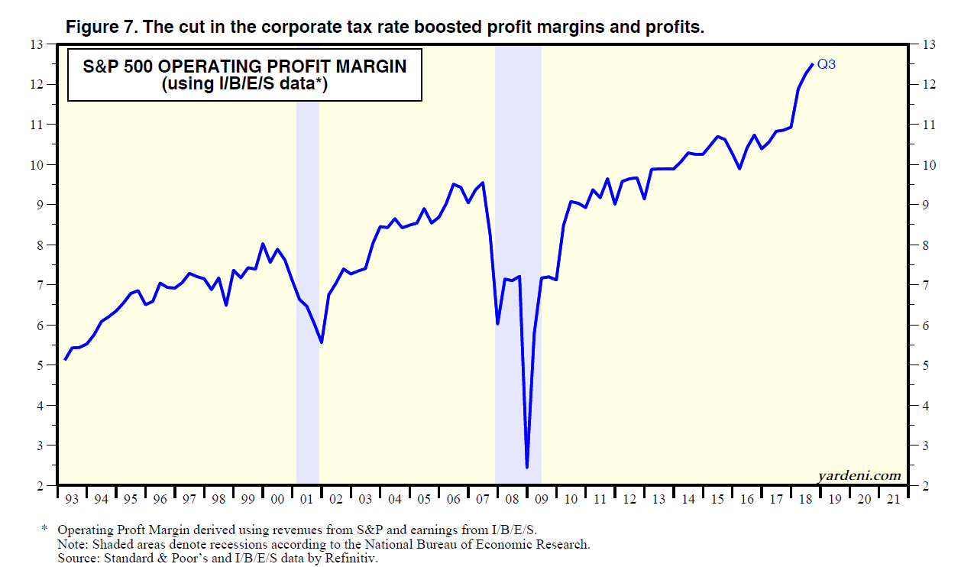

Slide 10
